Slide 1






WEBINAR
How to Build a Higher Education Admissions Chatbot that Doesn't Suck
Tuesday, January 10, 2023

Slide 2








Agenda
Speakers
Introductions & Quick Poll
What Makes a Bot Suck
The 5 Critical Attributes of a Good Bot
Use Case & Demo: Admissions Bot
Q&A
Chris Bechtel
VP, Global Marketing
Elia Karimi
Lead, Applied AI
Jed Suarez
AI Architect

Slide 3






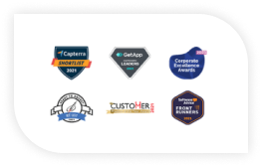







Comm100 Overview
Trusted by 15,000+
customers in
51 countries
Founded in 2009
100+ employees
4.7/5 on Capterra
Award-Winning
Omnichannel Software
Accurate omnichannel responses improve customer satisfaction
24/7 engagement with smart AI automation
Insightful analytics and reporting for better personalization
Experts in Higher Education, Healthcare, Banking & Finance & State/Local Government
Iron-clad Privacy
and Security

Slide 4




The chatbot was so unhelpful.
Why is it taking so long to check my student status?
Growing expectations have exposed gaps in service.
Is it safe to text my billing information for my tuition?
Please respond to my complaint on Twitter.
My classes are during the day so I can only respond in the evening or on the weekend.
I sent my inquiry through text and never got a response.
Why is live chat only available on weekdays?

Slide 5
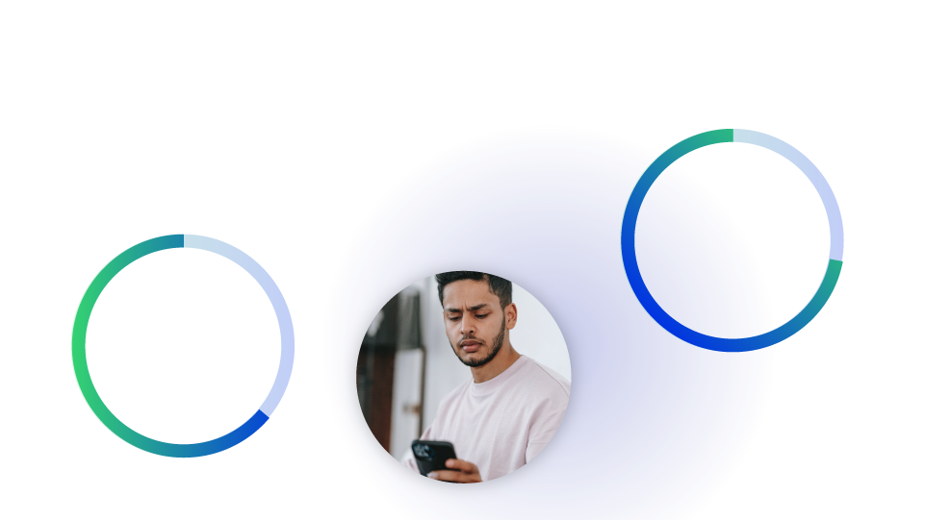



The majority of today’s students prefer digital channels.
Of all demographics, Gen Z are most open to chatbots and are most likely to agree that bots make it quicker for their issues to be resolved.
77%
of Gen Z ”expect consistent interactions across departments”
65%
of Gen Z prefer to engage through digital channels
60%
of Gen Z say they “hate making phone calls”

Slide 6




Attributes of Bots that “Suck”
Limited availability
Less than 24/7 support.
Confusing answers that push users away
Rather than concise and accurate conversations, the chatbot presents long and confusing answers that frustrate the user and push them away.
Insufficient bot training
The chatbot only contains 1 or 2 question variants which makes it hard for the NLP Engine to recognize the user's intent.
Outdated content
Answers are outdated and require constant updating by Bot Administrators.
No personalization
An answer-only bot that has no personalization or data enrichment through integrations with other systems such as your CRM, ERP or others.

Slide 7




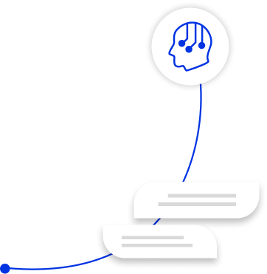



AI-Powered Automation
With our AI Platform, in just 2 weeks from now you will:
Scale reach and operations by using conversational AI to deploy chatbots and automation across channels
Reach students who would never pick up the phone – night owls, international students & weekend academics included
Answer conversations across channels without losing the thread – like being in more than one place at a time
Triple volume of support your agents and handle – with zero increase in human resources
Reduce support and service costs
Improve staff representative’s effectiveness
Easily manage spikes in volume
24/7 availability for students

Slide 8



The 5 Critical Attributes of a Good Bot
Automate routine tasks
Properly trained AI
Fresh content automatically captured from your website
24/7 availability on your website
Personalized and enriched conversations

Slide 9

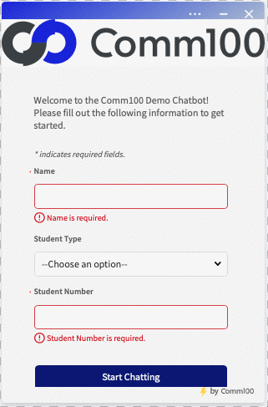
A bot can estimate housing prices for students:
Automate routine tasks
Transactional bots
Retrieve specific data from a customer record
Reduce repetitive work by automating common and time-consuming queries
Can calculate repetitive inquiries very quickly, such as housing prices
Some benefits include:
Increasing support capacity
Giving agents more time to focus on complex/higher value questions/other tasks
Reducing wait times
Cutting support costs
Notes:
Elia's Notes: Transactional bots do such things as retrieve specific data from a customer record and interact with people via email to automatically complete tasks such as finding an available meeting time in your calendar and moving data from one platform to another. Also, it can reduce repetitive work by automating common and time-consuming queries such as providing Housing Estimates to prospective students, which may be something that takes 5-10 minutes for an Agent to calculate, but is done almost instantaneously with the Bot, as shown in the Gif!

Slide 10
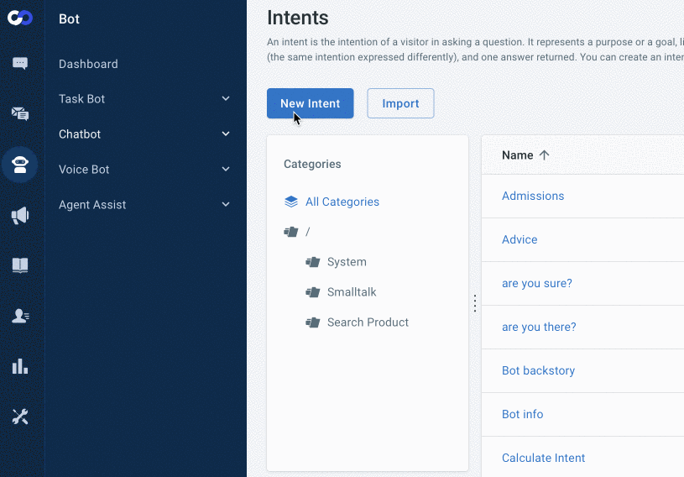


Properly trained AI
Each intent contains a solid number (10+) of Question Variations
Retrieves specific data from a customer record
Question Variations in Backend
Intent with Incorrect Spelling
Intent with Correct Spelling
Notes:
Jed's Notes: Question Variations are the one of the important module which seamlessly works with Intents. Question Variations allows to add multiple questions so that it helps to process the user inputs more effectively by our Natural Language Processing engine

Slide 11
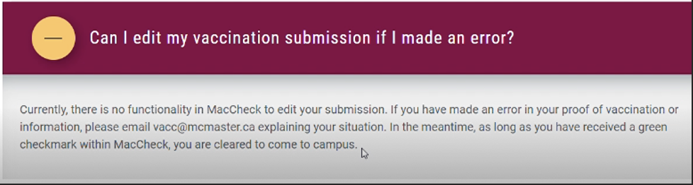
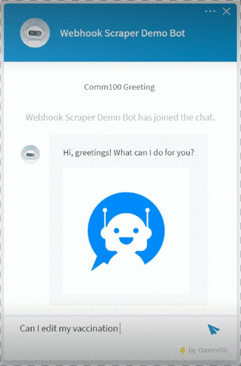
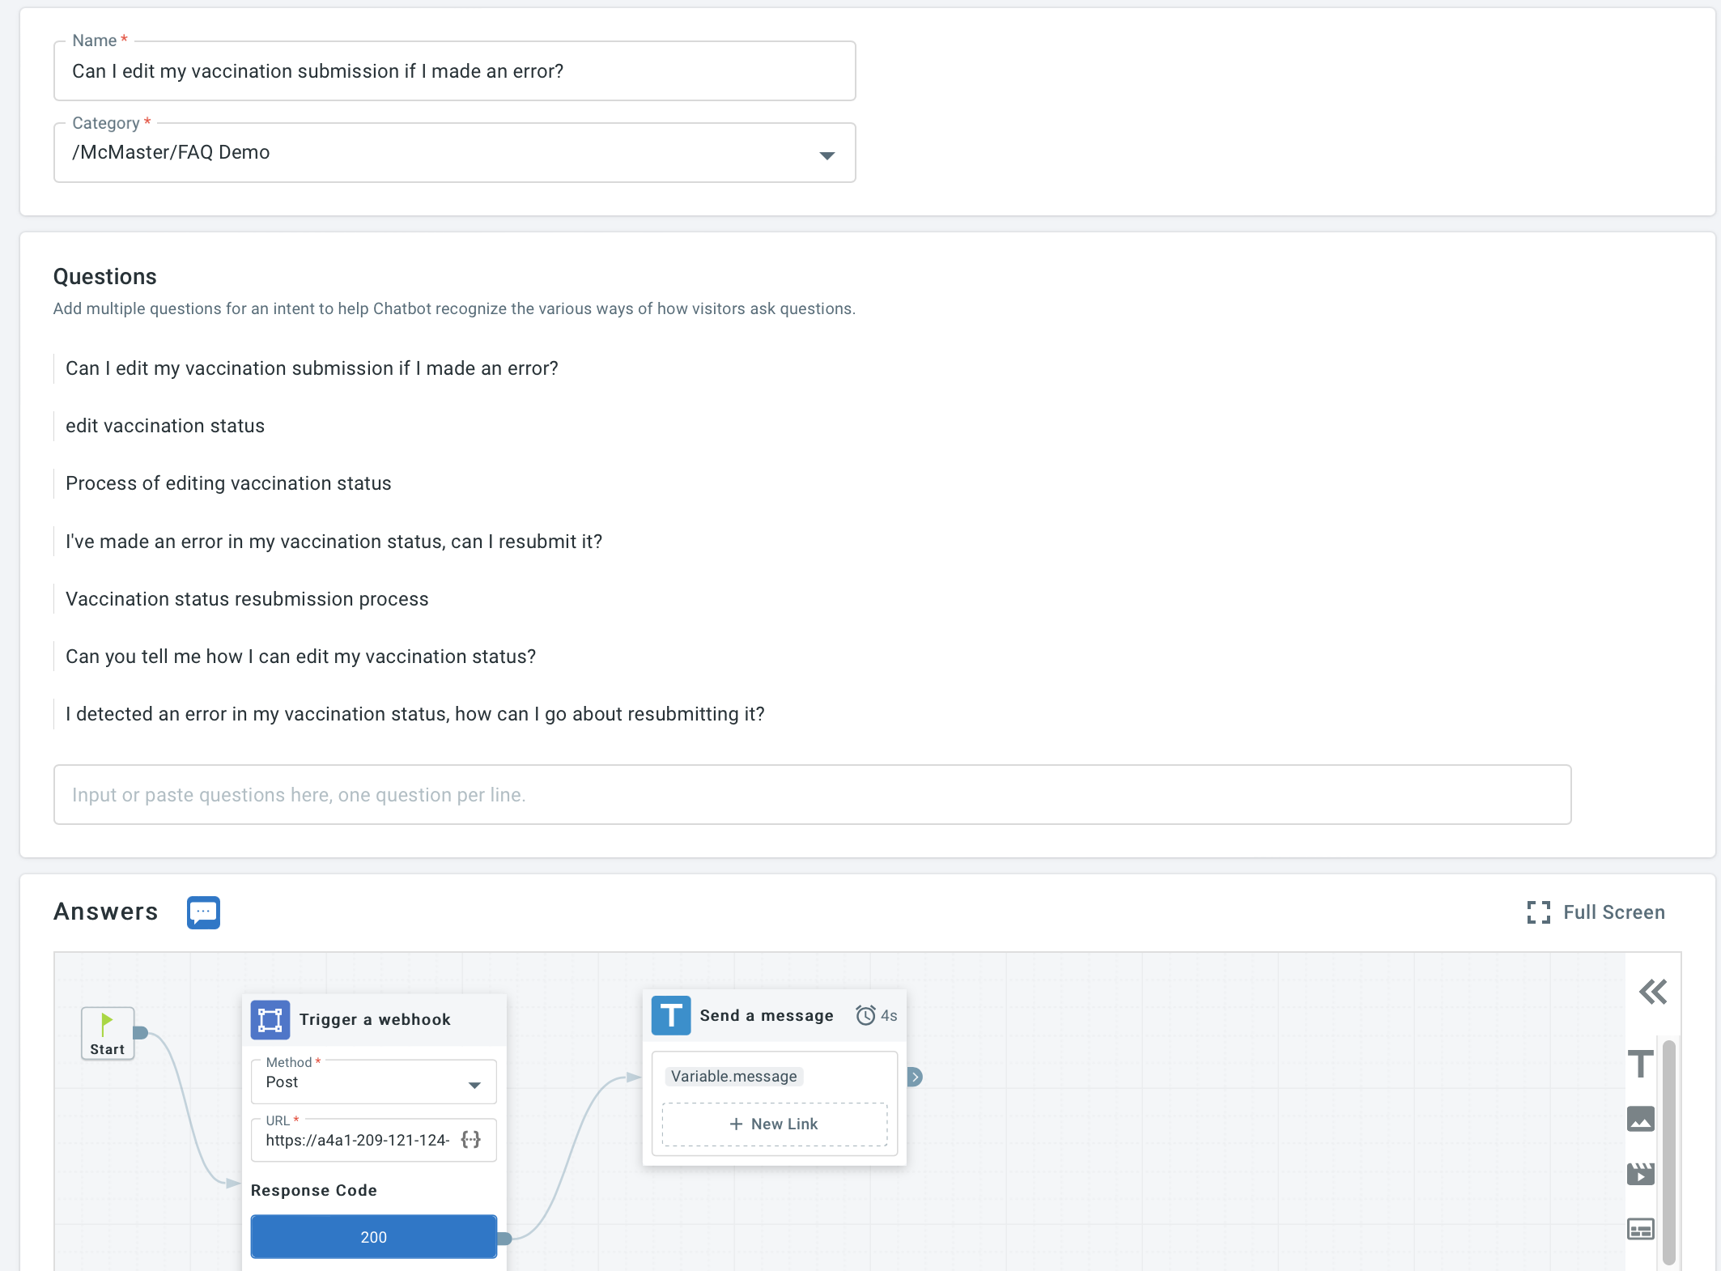
Fresh content automatically captured from your site
  Webhooks can be used to automatically update the chatbot intents based on the changes to a particular page on a website.
Content to scrape
Scraping in Progress
Backend of Bot Intent
Notes:
Elia's Notes: Webhooks can be used to automatically update the Chatbot intents based on the changes to a particular page on a website. Example: Customers end goal is to extract the information from the site and have it handy whenever a visitor asks a question via the Bot. From the backend, we can see there are no hardcoded answers, but merely a Webhook call and a message that is displayed to the user. What happens here, is that when the Midserver receives the webhook call for a specific question, it retrieves the webpages full source HTML, and in turn, findings a specific answer ID for the specific question being asked and returns the answers content as a Webhook response.

Slide 12
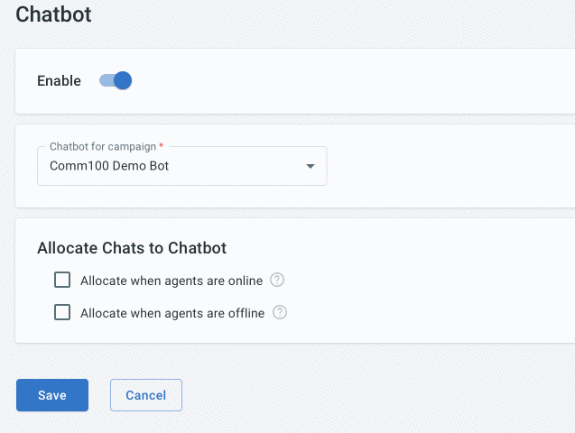
24/7 availability on your site
Increase engagement with domestic and international students by being available around-the-clock.
Even when the chatbot can't resolve the issue on its own, it can take a message for an agent to respond to when they are back online.
Reduce email and call volume by diverting traffic away from these channels and towards the 24/7 bot.
Chatbot allocation setting
Notes:
Jed's Notes: By having it available 24/7, our Chatbot can increase engagement with domestic and international students. Also, it can reduce email and call volume by delivering immediate, 24/7 support.

Slide 13
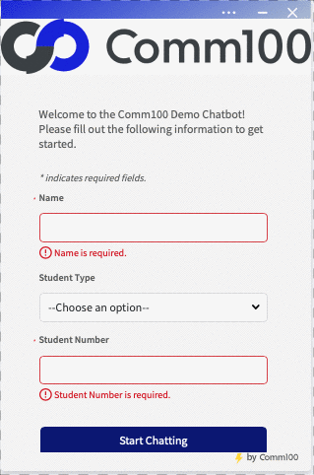
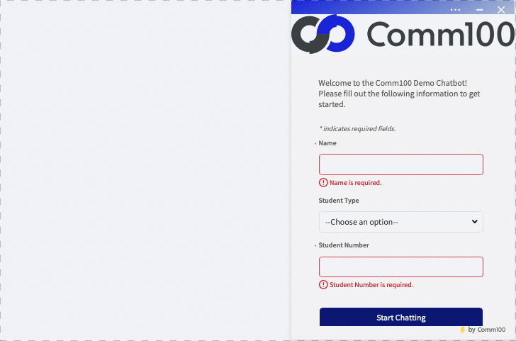
Personalized & enriched conversations
Use integrations with your CRM, ERP, Admissions, and other systems to provide agents with data that:
Drives efficiency
Increases personalization
Helps build relationships
Housing Admission Status
Room availability checker
Notes:
Elia's Notes: Our Chatbot allows your customers to interact with a Chatbot to receive information about products or services quickly and efficiently by sending data to your own web application using a “Webhook”. A Webhook is a custom web callback query used to provide real-time information. This can in turn lead to higher efficiency across your department as routine tasks such as checking a specific students Housing Admissions Status or providing up-to-date Room availabilities for students looking to reside on campus can be automated via Webhooks, as shown in the two Gifs!
Something to also point out here is that if a chatbot doesn't have webhooks or API integrations, it may not be able to connect with other systems or platforms. This can limit its capabilities and make it less useful for users. It's important for a chatbot to have webhooks and API integrations to enable it to interact with other systems and provide a more comprehensive and useful service to users.

Slide 14
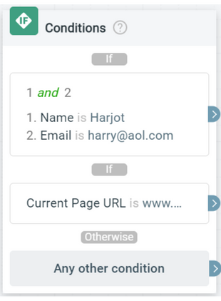
Bots & Automation
AI Chatbot Integrations and Webhooks
Webhooks
Custom web callback query used to provide real-time information
API Integrations
Integrating with existing services/systems
Custom Variables
Uses HTML Document Object Model (DOM) or JavaScript variables to read your website's information
Conditional Logic
Feature used within a chatbot answer flow that changes the path a visitor will take based on information about them
Notes:
Webhooks:
Comm100’s Chatbot allows your customers to interact with a Chatbot to receive information about products or services quickly and efficiently.
However, you may need to extend the capabilities of our Chatbot by connecting it to your own database for more personalized and dedicated service.
Now, with the latest update, our Chatbot can send data to your own web application using a “Webhook”. A Webhook is a custom web callback query used to provide real-time information.
To set up these new personalized questions, you can supply Chatbot with a URL of the web application to receive the Webhook data and return the relevant information to our Chatbot service.
API Integrations:
While a chatbot on its own is a powerful customer service tool, using chatbots to their fullest potential means integrating them with your existing services and systems.
Whether your bot support sales, tech support, or both, you can integrate a chatbot with your CRM system to ensure data is shared across the platforms to achieve data clarity, consistency, and transparency across teams and throughout the customer lifecycle. It also eliminates the need to manually log interactions and update data.
Custom Variables:
Comm100 Live Chat Custom Variable uses HTML Document Object Model (DOM) or JavaScript variables to read your website's information. Now Custom Variable will also retrieve QueryString from URL which is not JavaScript based.
To utilize custom variables, you need to have that content or information on your website already, and then specify the DOM, JavaScript variable expression or QueryString from the URL in Comm100 Live Chat to read that content or information to your chat console.
Conditional Logic:
Conditions are a step that can be used within a chatbot answer flow that changes the path a visitor will take based on information about them. In Comm100 Bot, you can add conditions via the Conditions action in the Intents-Answers and Event Messages flow builder.

Slide 15
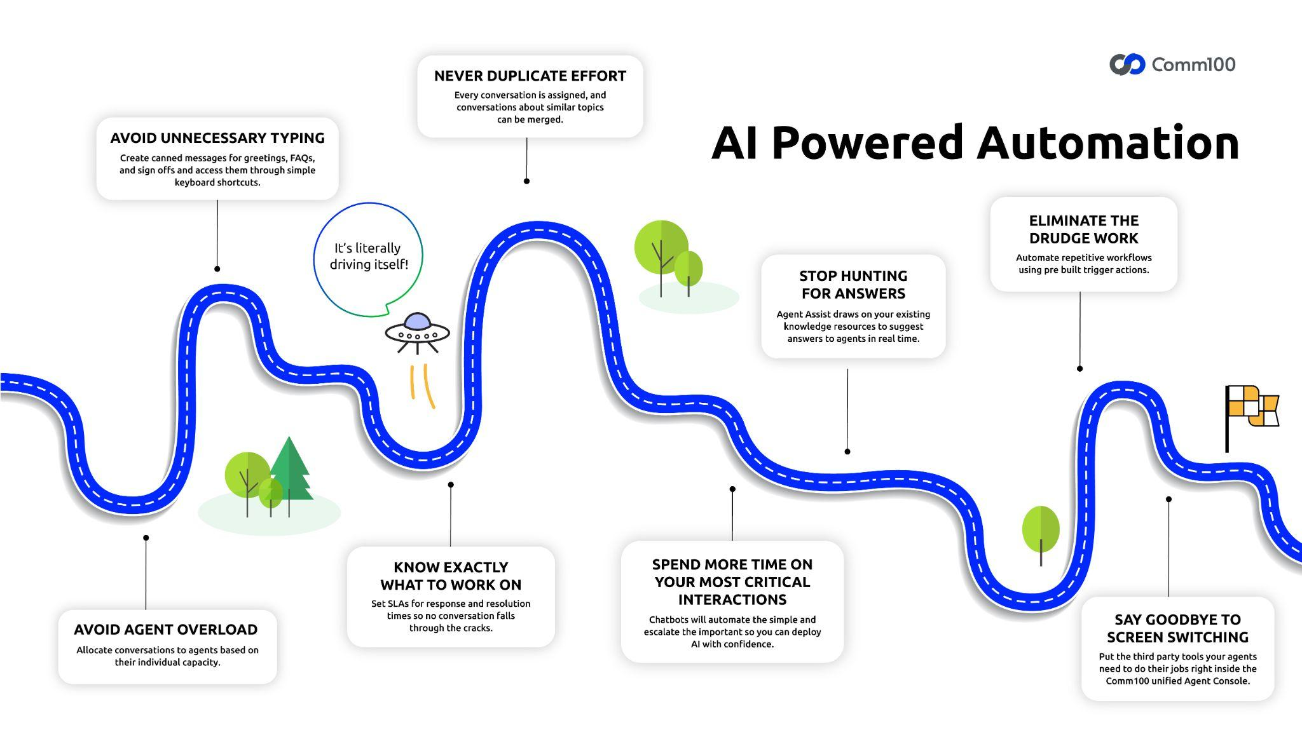

Slide 16
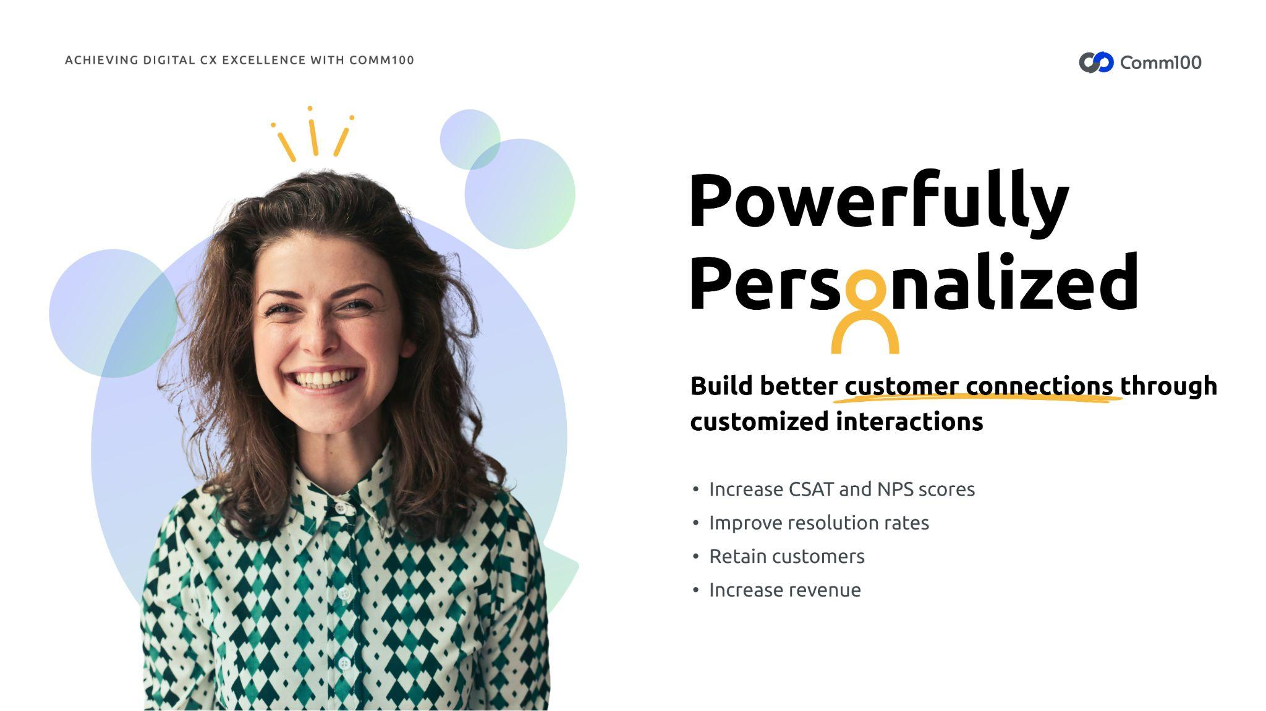



Powerfully Personalized!
Build better customer connections through customized interactions
Increase CSAT and NPS scores
Improve resolution rates
Retain customers
Increase revenue

Slide 17




Use Case Example: Higher Ed. Admissions
Typical Business Objectives and Outcomes:
Increase enrollment by Improving the prospective students’ experience
Mitigate staff member hiring and training challenges and improve staff member efficiency
Reduce repetitive work and automate your student engagement, 24/7
Reduce your email and call volume
Manage emails more efficiently
Provide essential reminders and updates for prospects to keep top of mind during the enrollment period

Slide 18

Admissions Bot Demo
See how easy it is to build, deploy and maintain an advanced NLP chatbot.

Slide 19

Cambrian College Improves Recruitment with Comm100 Live Chat & Chatbot
Personalization
24/7 Support
In March 2020, Cambrian College partnered with Comm100 to implement its live chat software within Cambrian’s Recruitment department. The live chat agents are current students who field queries form prospective students and deliver the accessible and convenient support that Gen Z expect. Comm100 Live Chat also helps Cambrian College to provide personal, one-to-one support that they worried would be wanting without the ability to speak face-to-face on campus.
After a successful year and a half with Comm100 Live Chat, Cambrian College decided to add Comm100 Chatbot to their student support offering. The bot, affectionately named BernieBot after the college’s mascot, was set up to enable 24/7 support. They recognized that many of their students wanted to connect during out of office hours, particularly students abroad in different time zones. With a chatbot in place, Cambrian can now deliver around-the-clock support to any student, creating far more opportunities to connect with prospective students and boost their recruitment efforts.

Slide 20
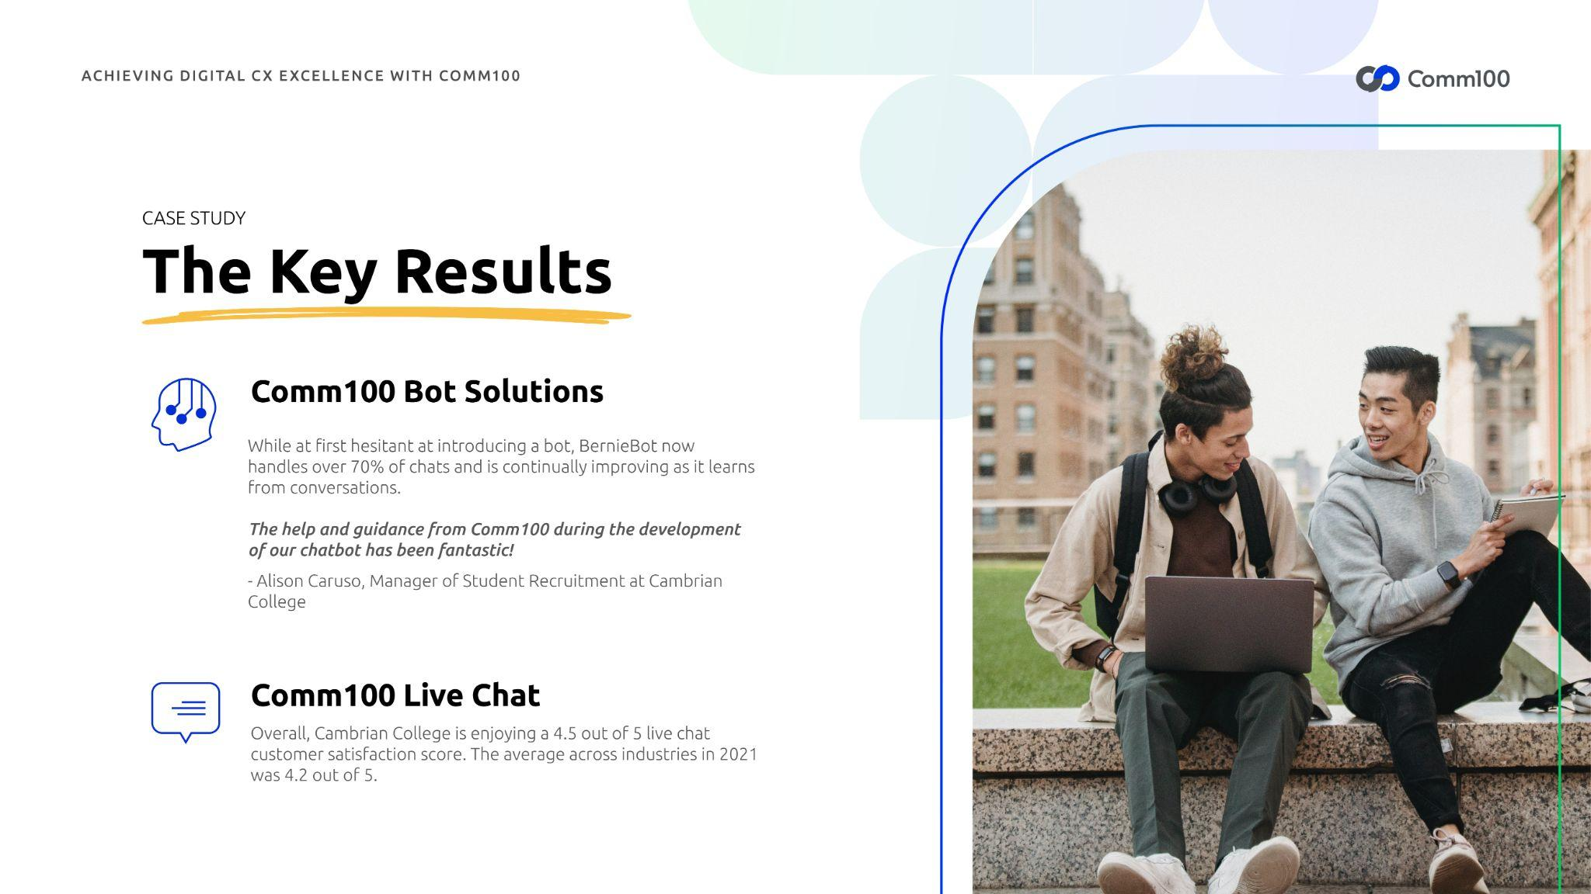

Cambrian College Key Results
Comm100 Bot Solutions
While at first hesitant at introducing a bot, BernieBot now handles over 70% of chats and is continually improving as it learns from conversations.
“The help and guidance from Comm100 during the development of our chatbot has been fantastic!”
– Alison Caruso, Manager of Student Recruitment at Cambrian College
Comm100 Live Chat
Overall, Cambrian College is enjoying a 4.5 out of 5 live chat customer satisfaction score. The average across industries in 2021 was 4.2/5.

Slide 21
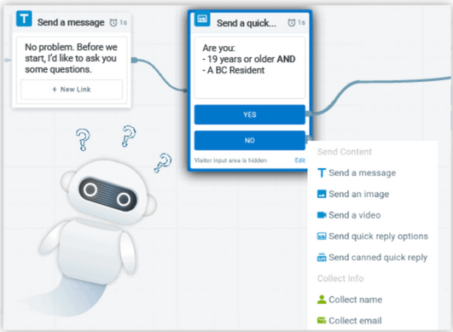

Bots & Automation
What are the technical details of the AI Chatbot?
Flow Builder
Intuitive and code-free bot building interface
Machine Learning
Trains with real visitor questions, becoming smarter over time
Bot-Agent Cooperation
Complete control on transferring to a Live Agent
Comprehensive Reporting
Robust reporting suite to monitor and measure chatbot performance
World-class capabilities, easy setup and maintenance
Get your chatbot active within 30 minutes!
Notes:
Flow Builder –
We designed the Comm100 Chat Bot interface for simplicity and speed, with no code or technical skills required!
Machine Learning - The AI Chatbot uses Machine Learning to study conversations, identify gaps in responses, and suggest which answers might need improvement - This ensures your Bot is always improving and always up to date with the changing landscape of your customer’s needs
The secret to a good AI-powered chatbots solution is the ability to learn from conversations. Just like school, your bot needs someone to check on its answers from time to time. The Comm100 AI platform features a simple interface that lets you train your AI chatbot on the more complex questions quickly and easily
Bot-Agent Cooperation: Everyone knows that not all conversations are meant for bots. When your visitors have especially complex needs, or a VIP logs on, you want to be able to take the reins of a chat or at least monitor the conversation. Comm100 AI Chatbot offers complete control over which conversations it handles, and when it hands them over to its human counterparts.
Comprehensive Reporting: Comm100 provides a robust reporting suite that allows you to measure the performance of your AI customer service chatbot. Detailed reports for the number of chats resolved by the bot, real-time Sentiment Analysis, and answer confidence allow you to prove ROI and identify opportunities to improve your chatbot. It also includes comparative reports between bots and agents, so you can understand how the bot measures up to its human counterparts.
World-Class Capabilities, Easy setup and Maintenance
Our Chatbot combines powerful AI with an easy-to-use, code-free UI so that you can have the confidence, control, and comfort you need to take full advantage of everything that AI has to offer.

Slide 22
Q&A

Slide 23



Next Steps
Schedule a discovery meeting with us to see how we can help you solve your problems!

Slide 24




Thank you
Learn more
comm100.com

